Slide 1
DSA
Lect#5

Slide 2
Stack
A stack is a linear data structure with the restriction that insertions and deletions can be performed in only one position that is from the Top.

Slide 3
Stack(cont.)
Fundamental Operations on stack are:
Push()
Pop()
Is_empty()
Peek()
Size()

Slide 4
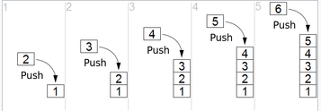
Stack (cont.)
Push ()
It inserts values into the stack

Slide 5
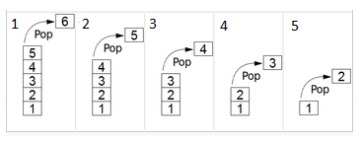
Stack(cont.)
Pop ()
It removes values from the stack

Slide 6
Queue
A list or collection with the restriction that insertion can be performed at one end (rear) and deletion can be performed at another end (front).
FIFO

Slide 7
Operations on Queue
Enqueue()
Dequeue ()
Is_empty ()
get_front ()
get_rear ()
size ()

Slide 8
Deque
It is another variation of queue
Deque is Double-Ended-Queue
Deque is a linear data structure
Both ends can be used for insertion and deletion

Slide 9
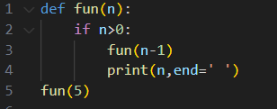
Recursion
A function calling itself is called recursion.
Example:

Slide 10
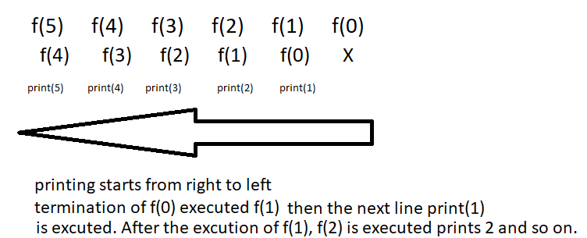
Recursion (cont…)

Slide 11
Recursive case
Here in the third line, we use fun(n-1)
Calling the function by using more
simpler way as fun(n-1) will become more
simpler in each recursion than the original
function fun(n).

Slide 12
Base Case
A case where the function stops calling itself.
Here we use the condition in the if- statement
i.e., if n>0
Ultimately, the function stops recursion
when n becomes 0

